Slide 1
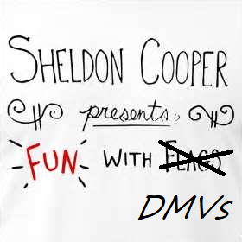

Fun With DMVs

Slide 2
About Me
LinkedIn: https://www.linkedin.com/in/angela-ross-innes-a108752a/
Email: SQLMarathons@gmail.com
Who am I?
I’m a DBA with Verizon Connect Ireland. DBA for the past 2 years, 12 years DB Dev before that. And I run. I run a lot, hence my email address :-D

Slide 3


Table & Index Definitions

Slide 4
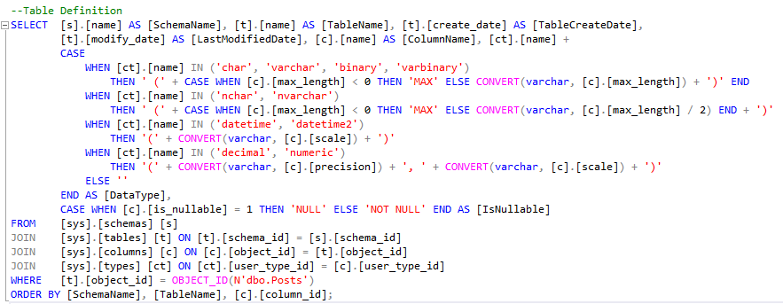

Table Definition

Slide 5
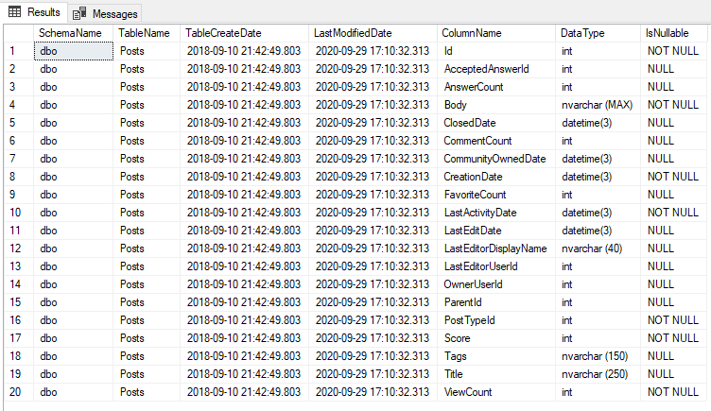
Table Definition

Slide 6
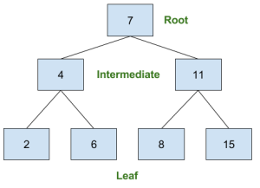
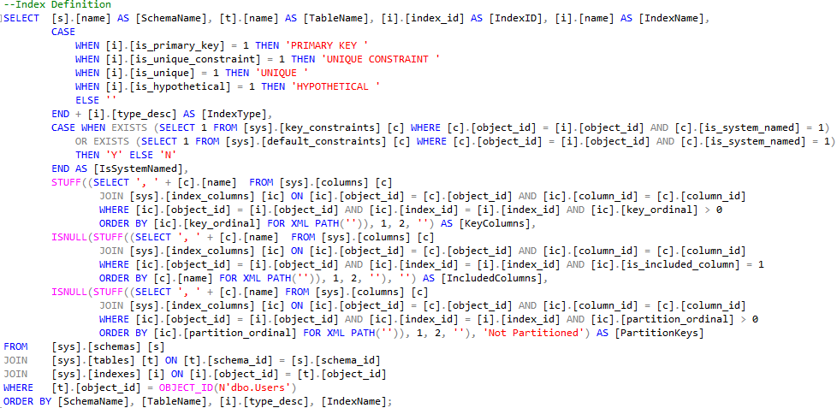
Index Definition

Slide 7
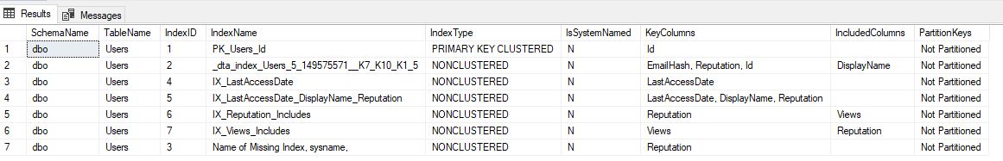
Index Definition

Slide 8


Stored Procedures and Usage

Slide 9
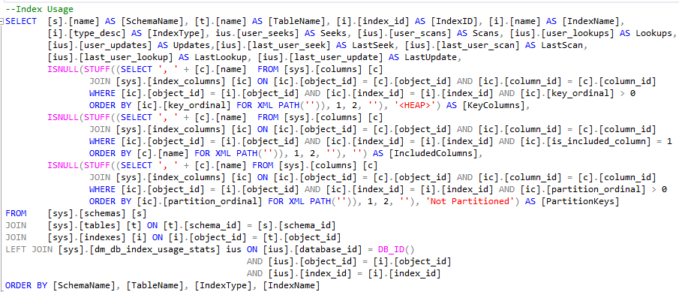

Index Usage (since last service restart)

Slide 10
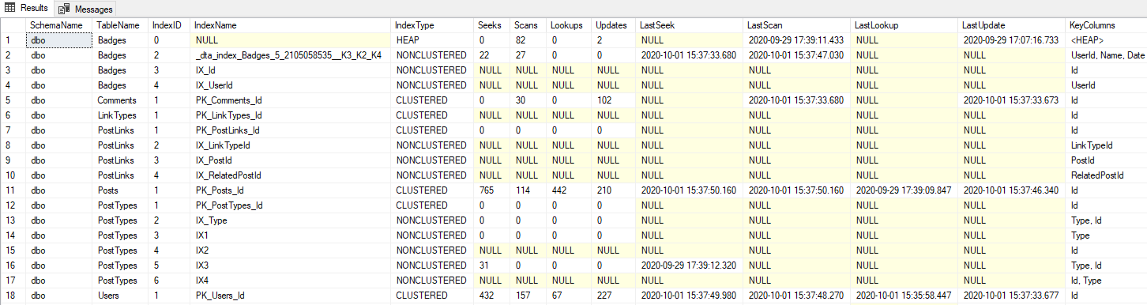
Index Usage (since last service restart)

Slide 11

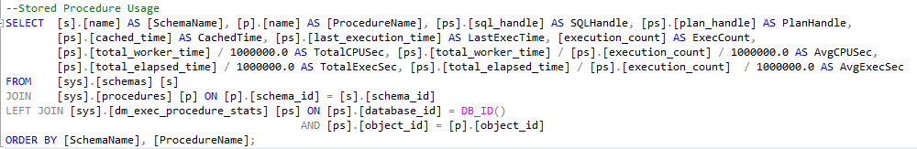
Stored Procedure Usage

Slide 12
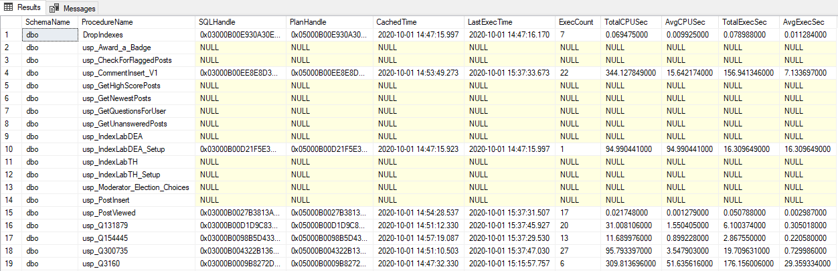
Stored Procedure Usage

Slide 13


Stats and Sizes

Slide 14
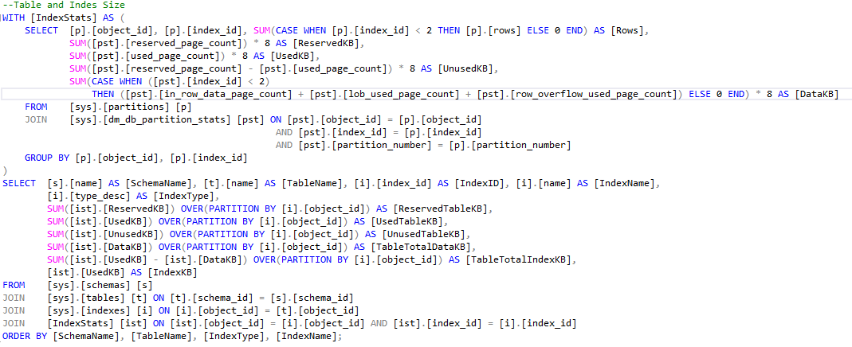
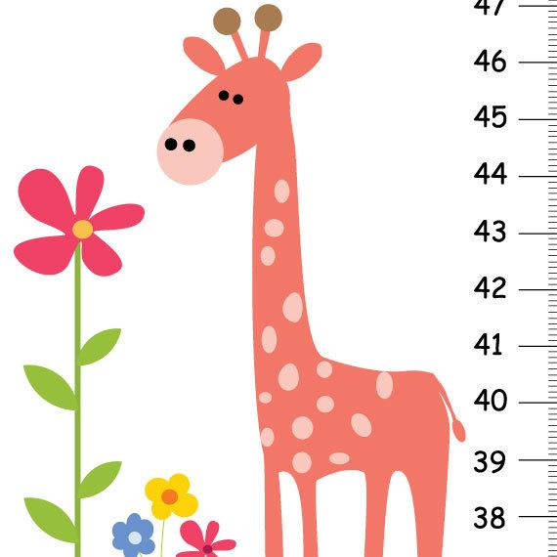
Table and Index Size

Slide 15
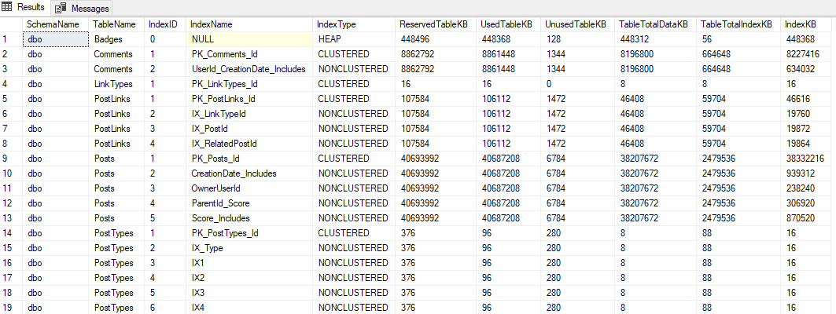
Table and Index Size

Slide 16

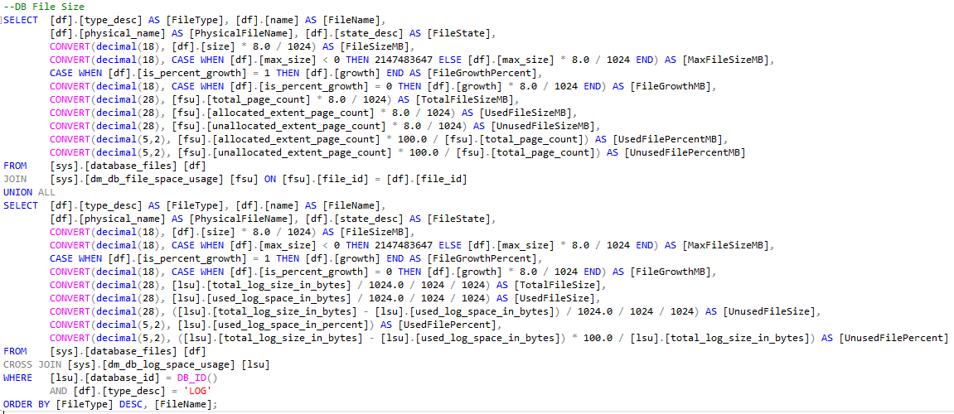
Database File Size

Slide 17
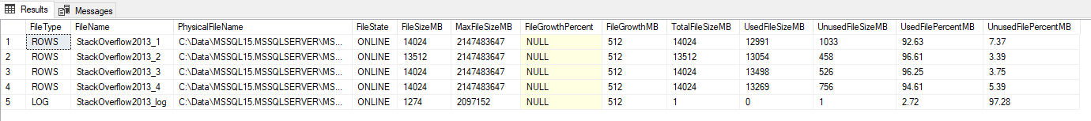
Database File Size

Slide 18



Let’s Dive a Little Deeper

Slide 19

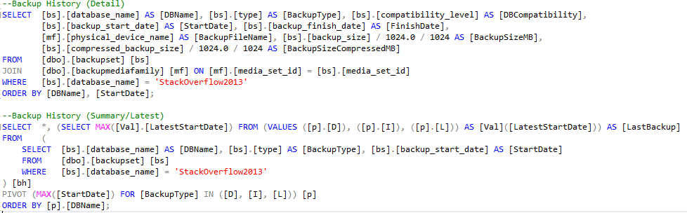
Backup History

Slide 20
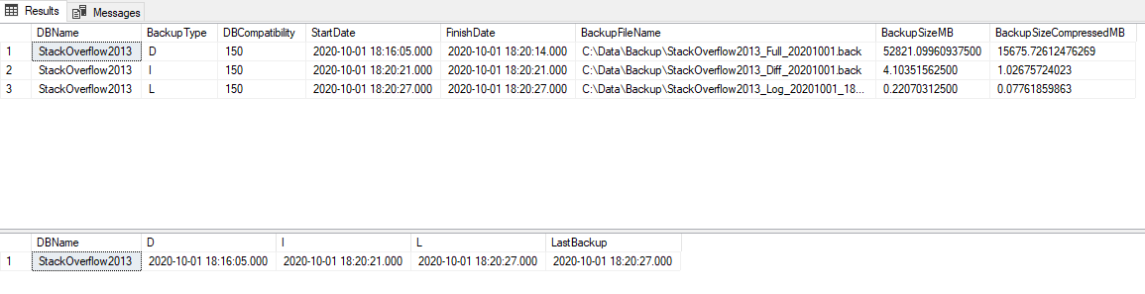
Backup History

Slide 21

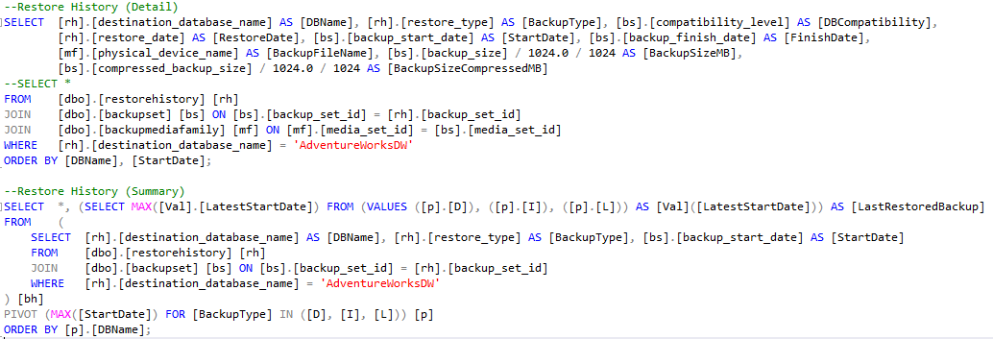
Restore History

Slide 22
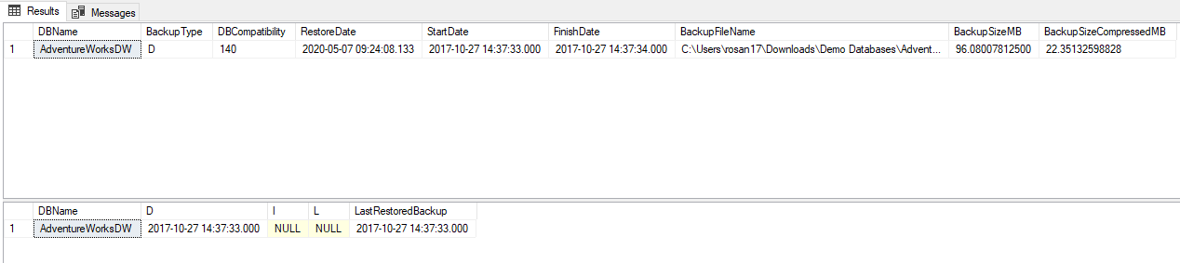
Restore History

Slide 23

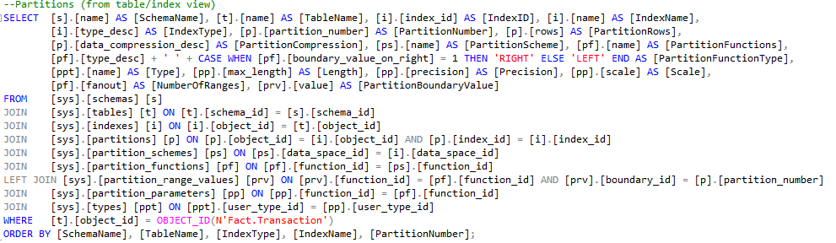
Partitioning (Table/Index)

Slide 24
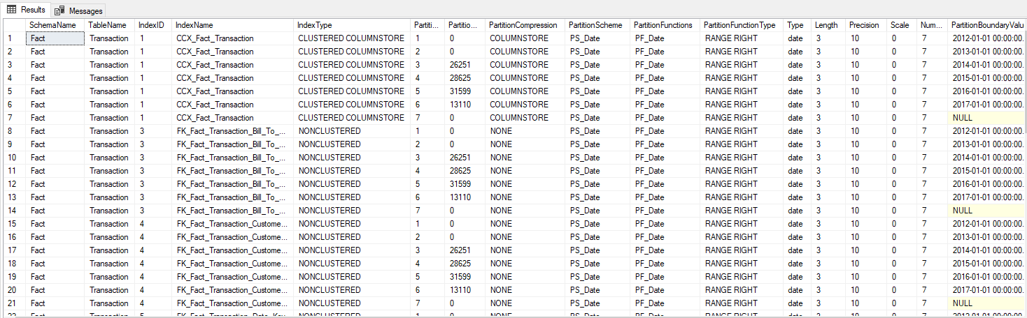
Partitioning (Table/Index)

Slide 25
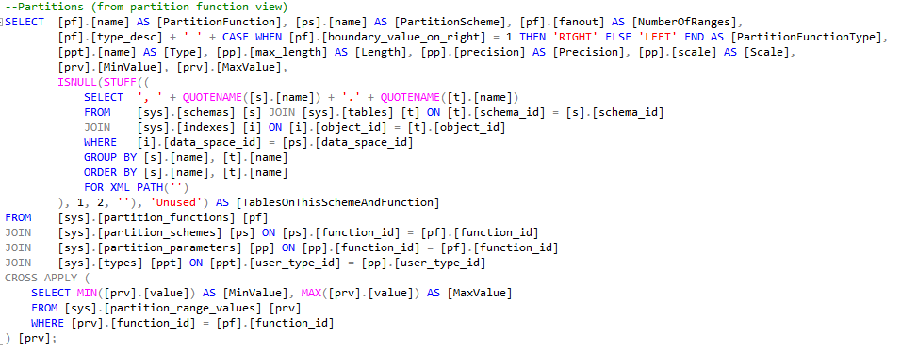

Partitioning (Function/Scheme)

Slide 26
Partitioning (Function/Scheme)

Slide 27

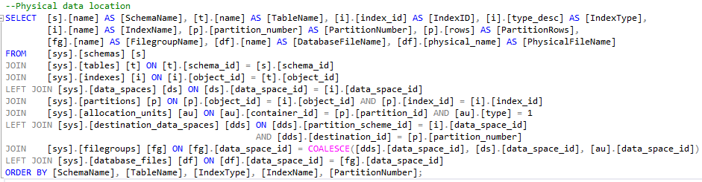
Physical Data Location

Slide 28
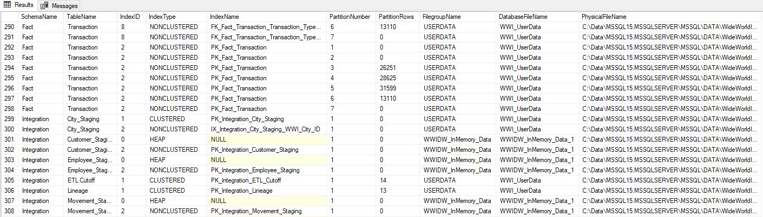
Physical Data Location

Slide 29

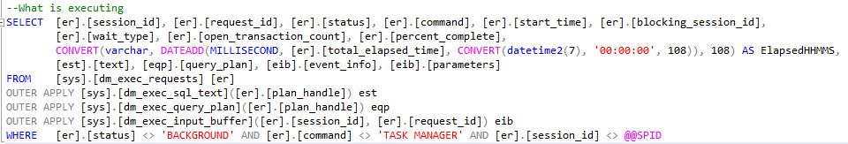
What is Running Now?

Slide 30
What is Running Now?
You can also use Adam Machanic’s sp_WhoIsActive SP: http://whoisactive.com/

Slide 31

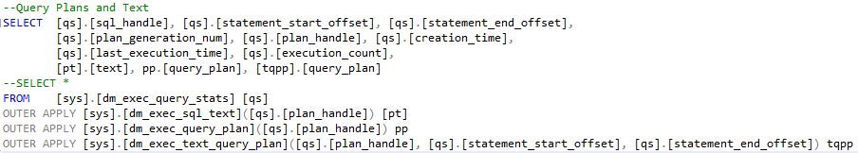
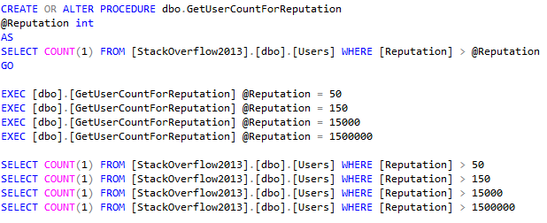
Query Plans and Query Text

Slide 32
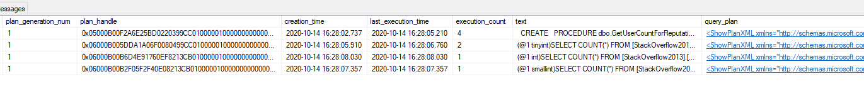
Query Plans and Query Text

Slide 33
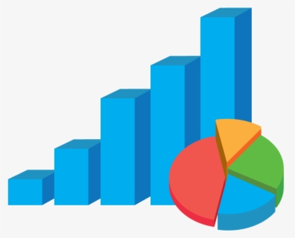
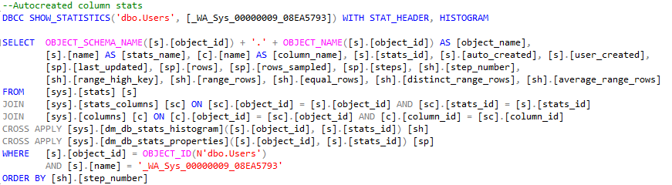
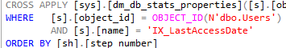
Table and Index Stats

Slide 34
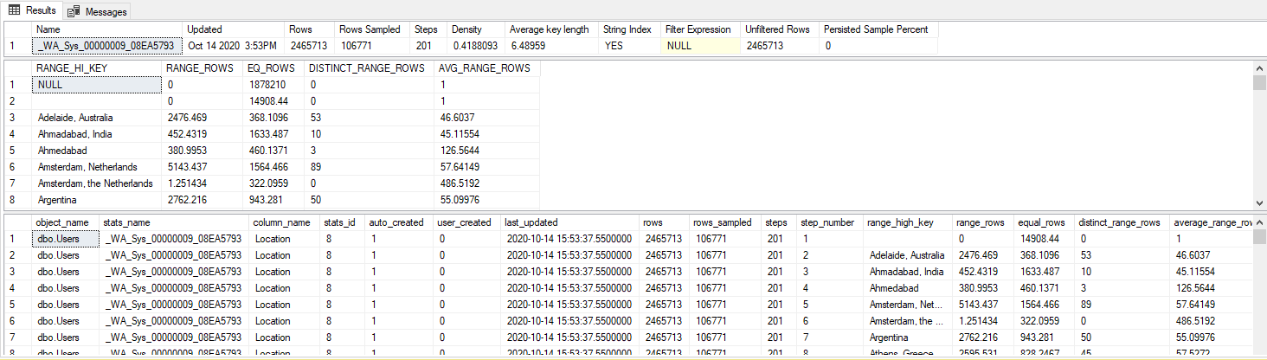
Table and Index Stats

Slide 35

Resources

Slide 36
Demo Databases
WideWorldImportersDW:
https://docs.microsoft.com/en-us/sql/samples/wide-world-importers-dw-install-configure?view=sql-server-ver15
StackOverflow2013
https://www.brentozar.com/archive/2015/10/how-to-download-the-stack-overflow-database-via-bittorrent/

